Slide 1
ARL RFE APEX APPLICATION
By Derek Truong and Charlotte Sheng

Slide 2
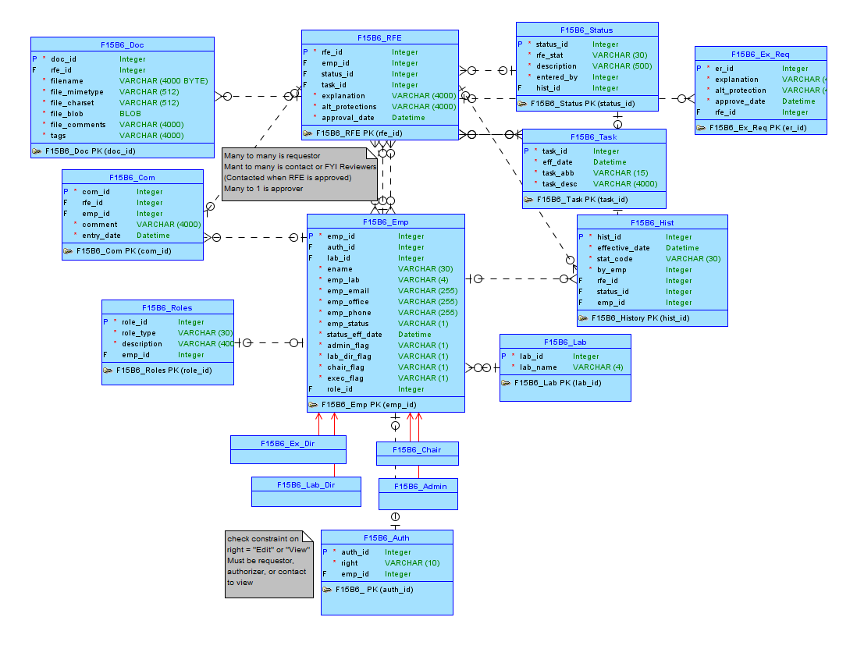
Conceptual Model

Slide 3
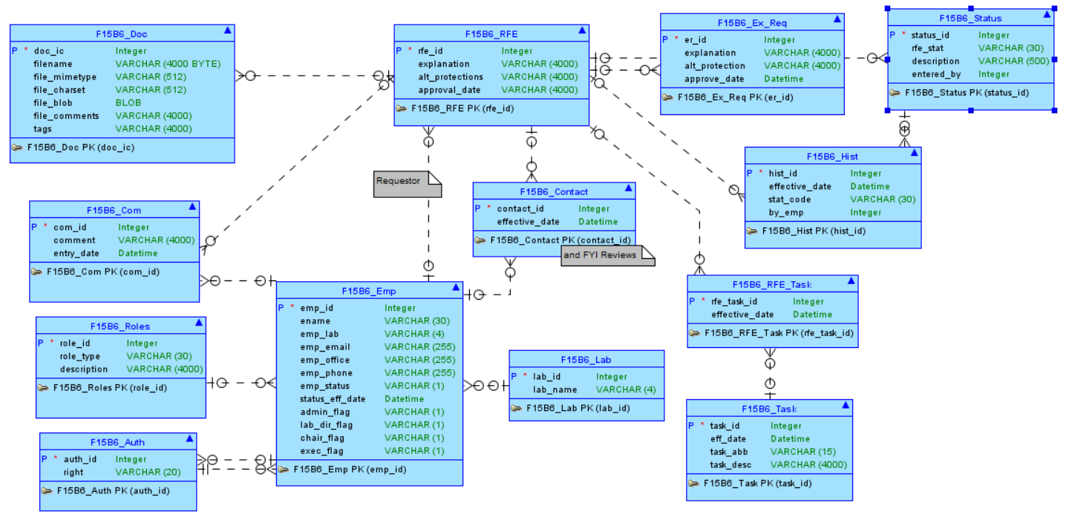
Logical Model

Slide 4
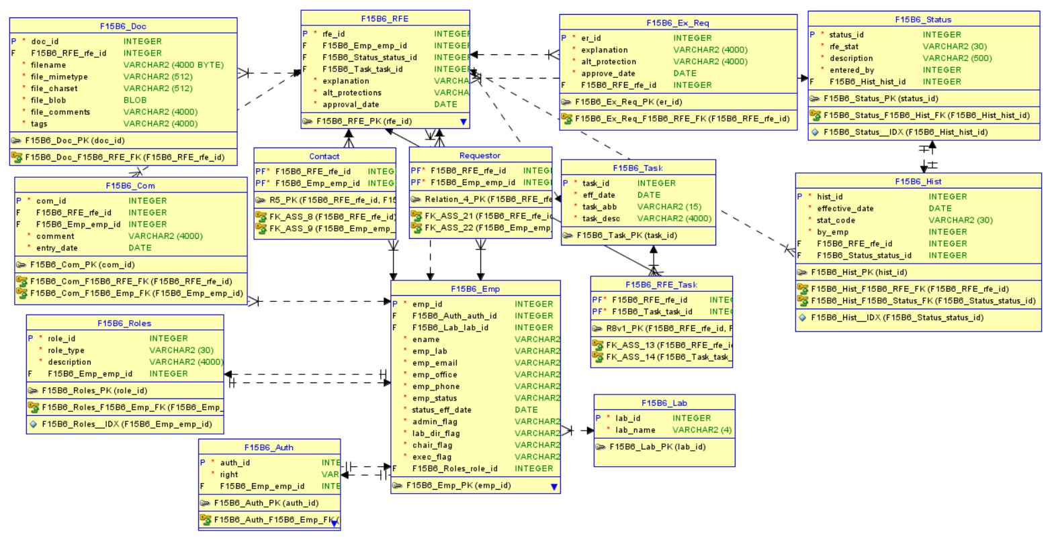
Relational Model

Slide 5
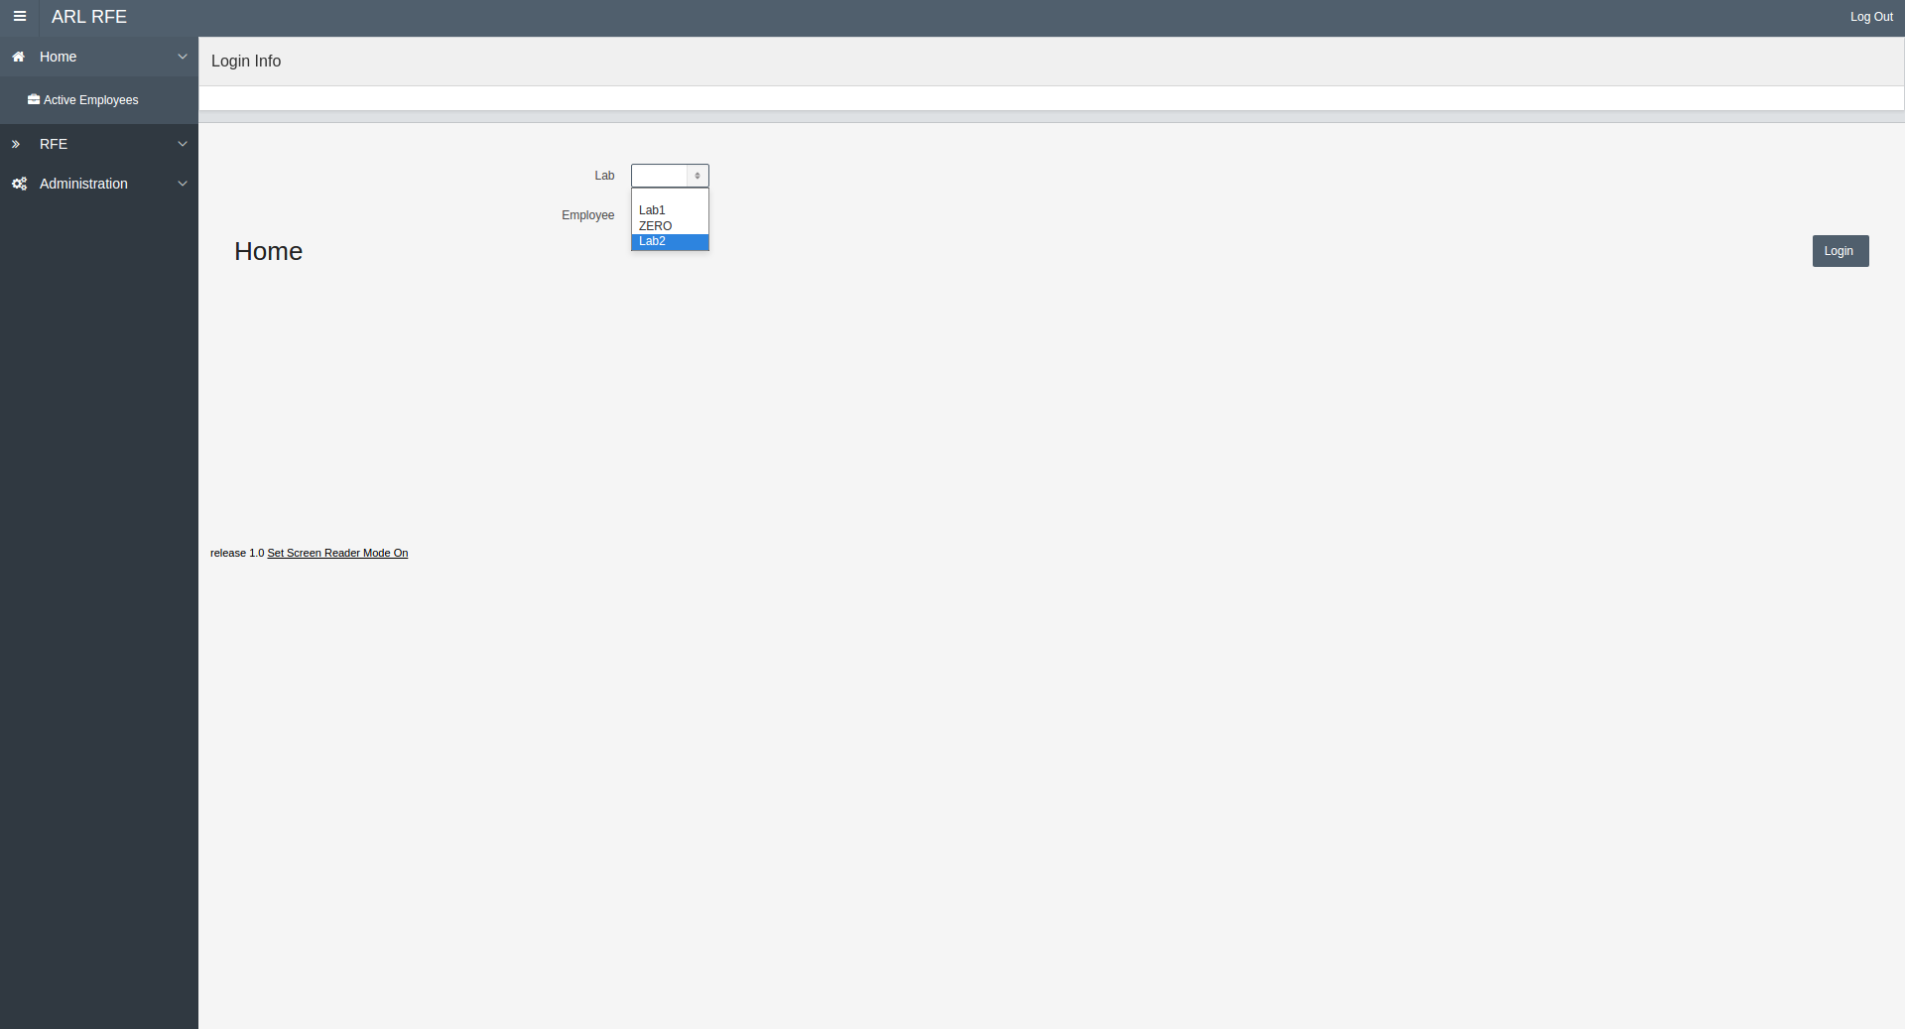
Login Page

Slide 6
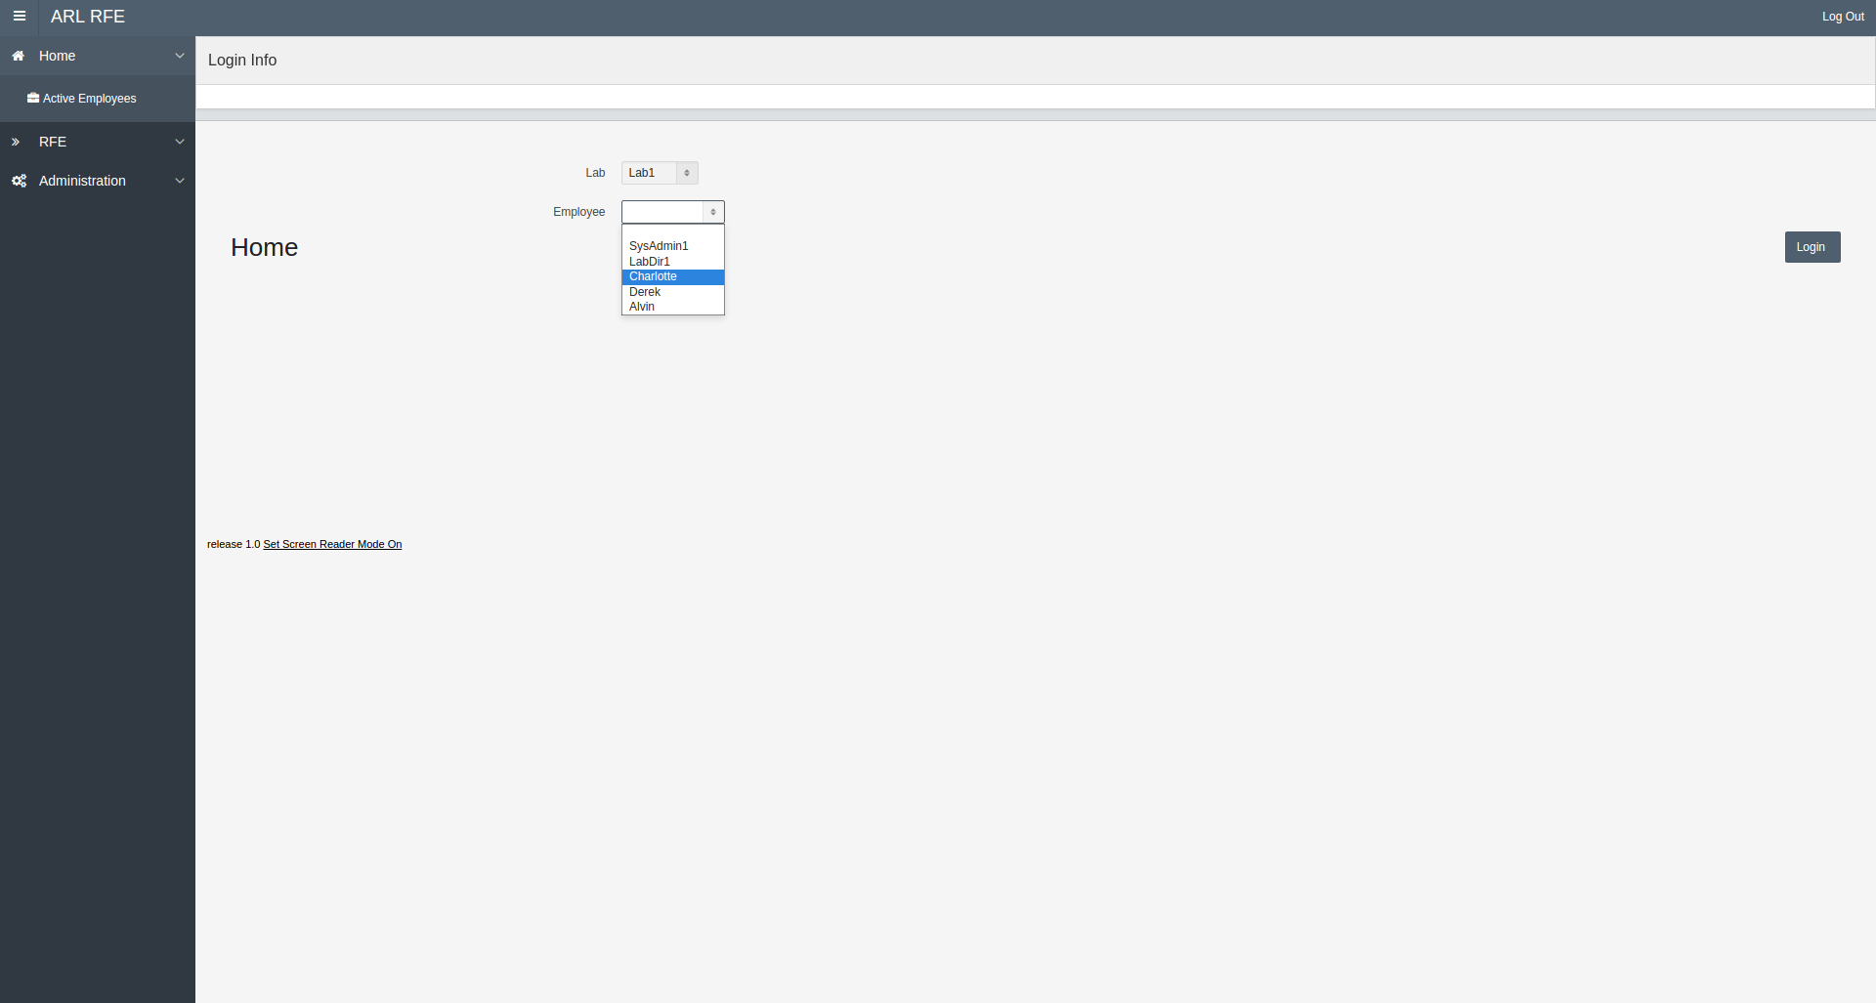
Employee Selection

Slide 7

Admin Selection

Slide 8
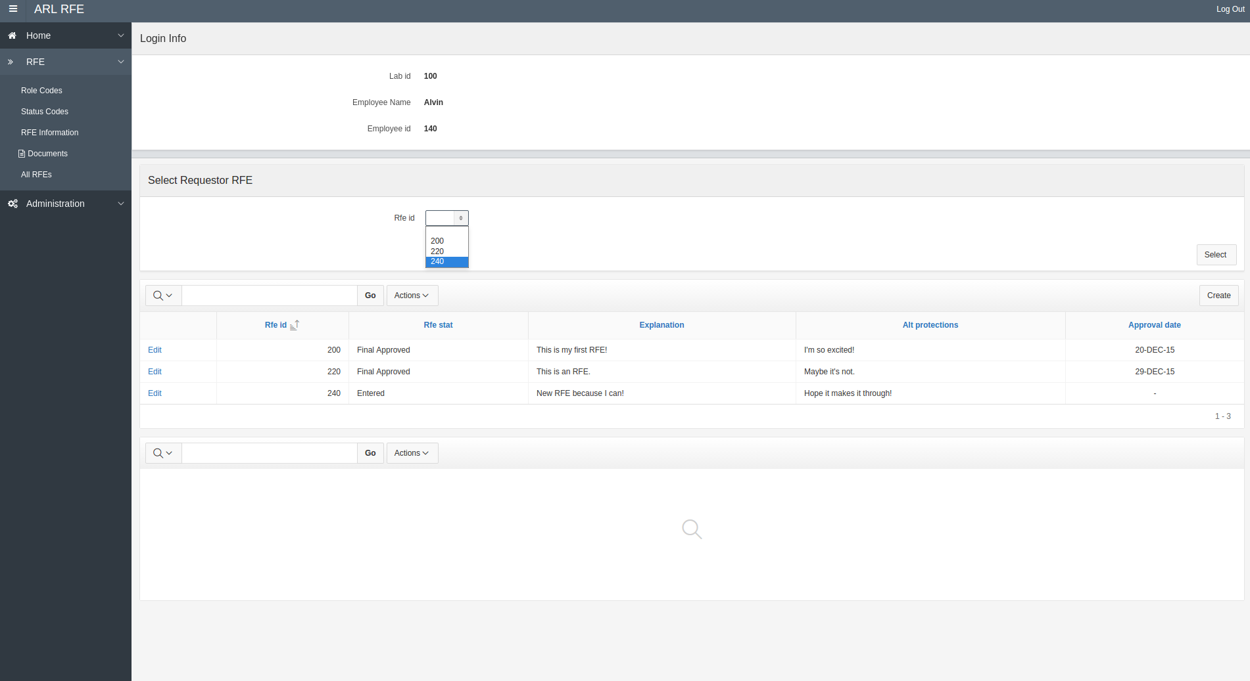
Employee RFE View

Slide 9
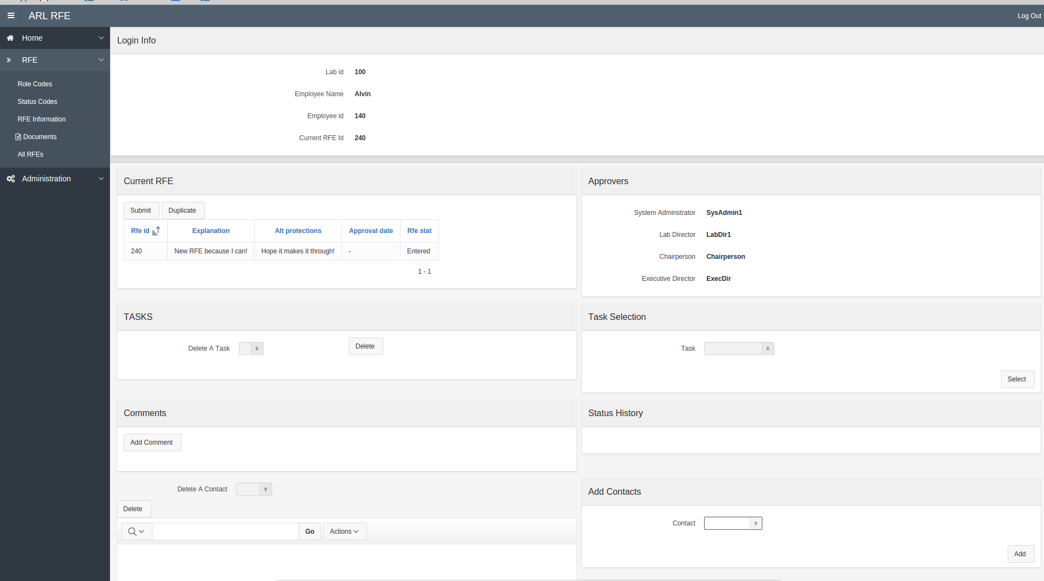
Employee RFE Info

Slide 10
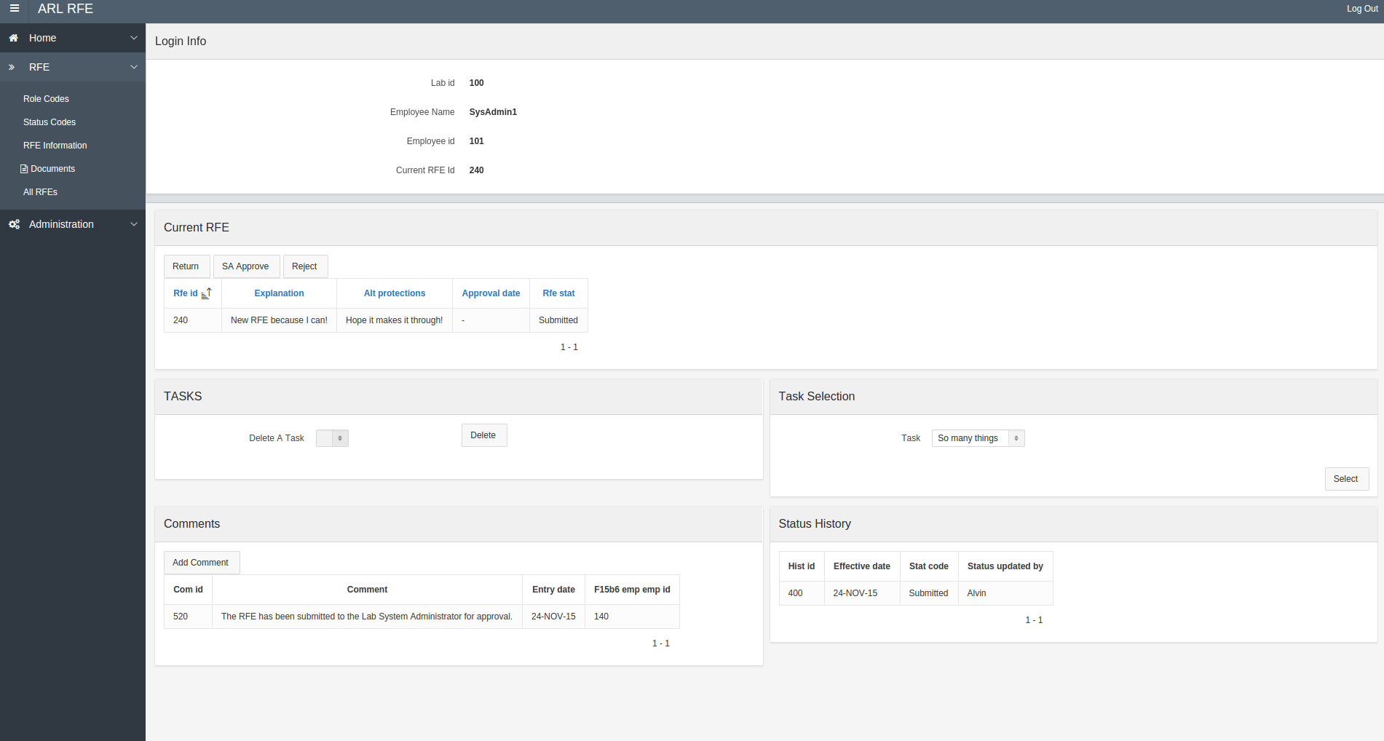
Approvals

Slide 11
Part II Application
Simulation of a database used to store intramural sports for any university and/or high school.
Consists of pages that display data of the:
Sports that are being played throughout intramurals
Teams that are currently registered
Page for all the team members of every team
The last page of the application is a query that allows for you to select a specific query in SQL and get JSON in return

Slide 12
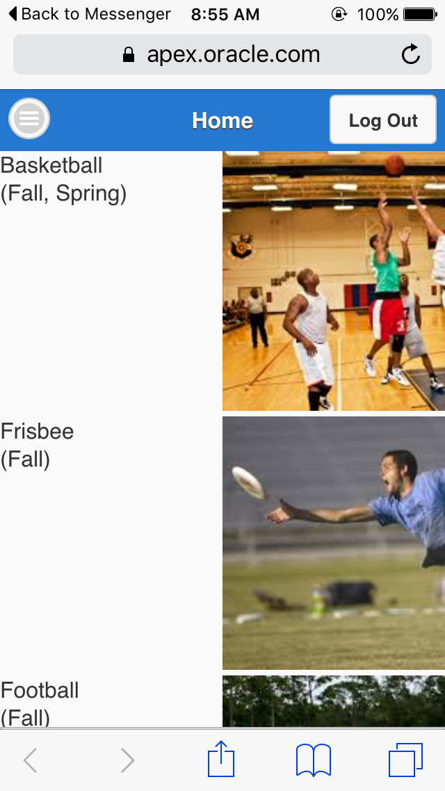
Phone Application

Slide 13
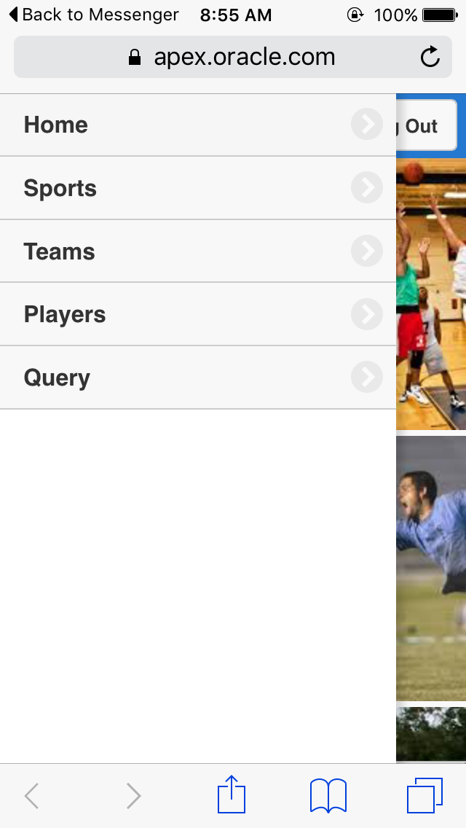
Phone Application

Slide 14
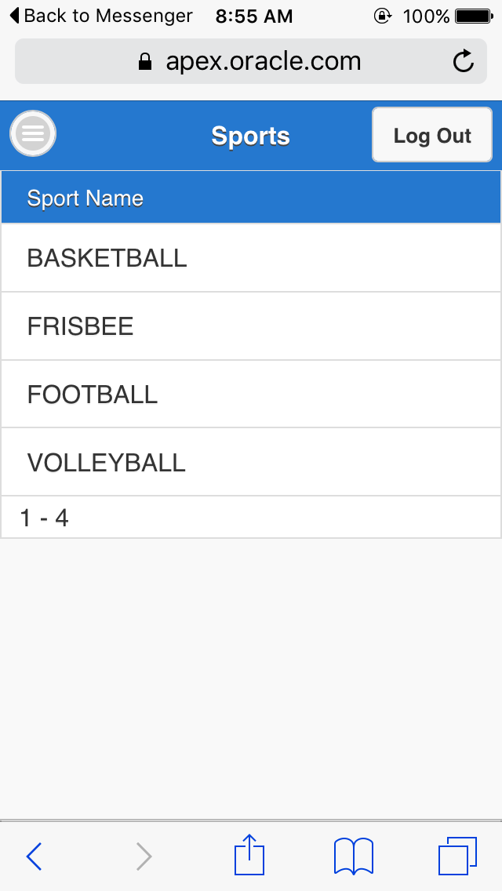
Phone Application

Slide 15
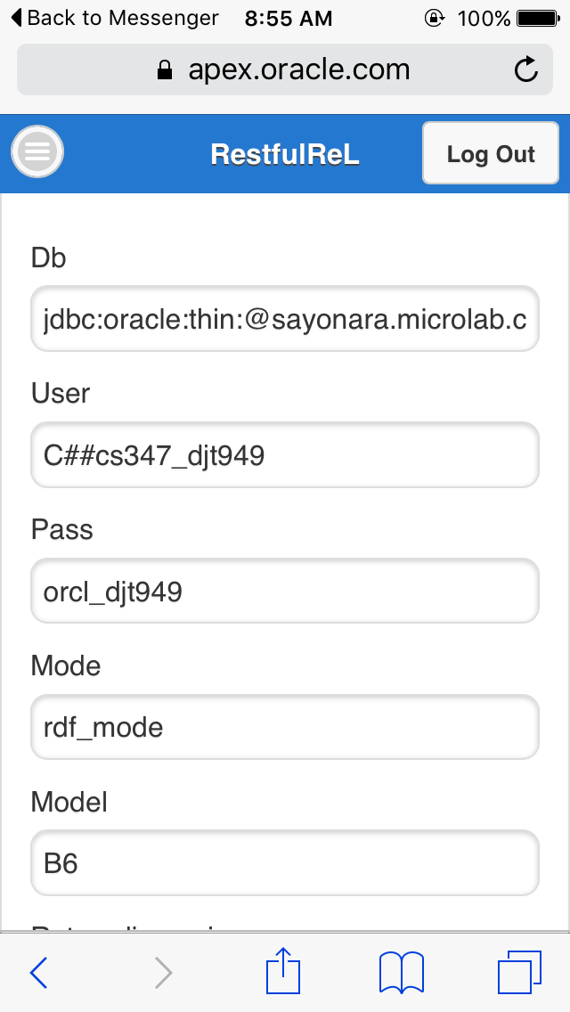
Phone Application

Slide 16
Github Repo
Github Repo

